Slide 1
Case of the month
Trans-oral Radiofrequency Ablation of C1 Lateral Mass Lesion
Jesse Jones
Assistant Professor
Director of HHT center
Neurosurgery Department
University of Alabama at Birmingham
Husameddin El Khudari
Associate Professor
Director of Interventional Radiology Medical Student Education
Division of Interventional Radiology, Department of Radiology
University of Alabama at Birmingham
Junjian Huang
Assistant Professor
Director of Interventional Radiology Clinical Research and Radiology Medical Student Research
Division of Interventional Radiology, Department of Radiology
University of Alabama at Birmingham
Musa Khan Bungish, MBBS
CMH Kharian Medical College
National University of Medical Sciences,
Pakistan

Slide 2
Clinical History
47 Year Old male with a previous medical history of acute lymphoblastic leukemia status post bone marrow transplant/chemotherapy, hypertension and congestive heart failure presented following a motor vehicle collision and was found to have a C1 Lytic Lesion on imaging.
He experienced severe pain at the base of his skull since the accident, most likely attributed to the accident.

Slide 3
Clinical History
Patient also began having episodes of daily dizzy spells following the accident, lasting several minutes with associated nausea. The episodes were spontaneous or associated with head movement, having 12-24 episodes daily. Patient denied associated syncope.
Initial CT without Contrast showed a well-circumscribed round lesion with ground-glass attenuation in the left lateral mass of C1, measuring 1.3 cm x 1.0 cm x 1.0 cm.

Slide 4
Clinical History
Follow up MRI 1 month after initial CT showed an increase in size of the lesion to 1.7 x 1.3 x 1.4 cm in AP.
Follow up MRI 6 months onwards showed unchanged size in the peripherally sclerotic lesion in the left lateral mass of C1.
Suspected Diagnosis was Osteoid Osteoma.

Slide 5
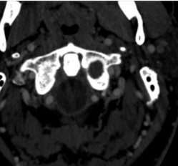
Initial Imaging
Figure 1.A
Figure 1.B
Figure 1.C
Figure 1:
A) Axial image of lytic lesion in the left lateral mass of C1.
B) Axial fused CT/bone scan demonstrating marked tracer uptake in the lesion.
C ) Axial computed tomographic angiographic image demonstrating robust arterial and venous structures prohibiting posterolateral access.
Axial In/out

Slide 6
Clinical Decision Making
Patient was initially started on conservative management including Ice, over the counter analgesics, and physical therapy.
Expanding size of lesion was worrisome and prompted further management.
Orthopedic referred to neurointerventional radiology for potential procedure related to the lesion.
Due to location of lesion, the decision was made to do concurrent biopsy and radiofrequency ablation (RFA).

Slide 7
Clinical Decision Making
Posterior approach was not possible due to proximity of the vertebral artery and vascular structures.
The decision was made to proceed with a transoral approach with recommendation for cement augmentation following ablation due to thinning of the cortex along the superior margin of the lesion, in contact with the occipital condyle.

Slide 8
Procedure
The procedure, indication, risks, complications and alternatives were discussed with the patient.
Risks included infection, bleeding, vascular injury, stroke, need for emergent surgery, coma and death.
Procedure was performed under general anesthesia.
Trocar was advanced into left C1 mass, and biopsy was performed.
Next, ablation probe was advanced into lesion and radiofrequency ablation was performed for 4 minutes.

Slide 9
Procedure
Probe was replaced with a kyphoplasty stylet to attempt cement augmentation, however significant resistance was faced when injecting methylmethacrylate.
CT showed appropriate positioning, raising suspicion for premature polymerization, requiring ENT consult to remove stylet.
Patient was extubated, recovered and discharged in good neurological condition.

Slide 10
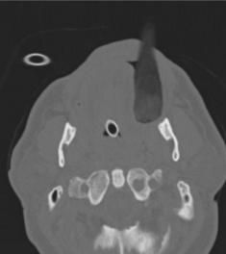
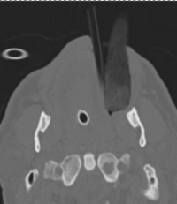
Procedural Images
Figure 2.A
Figure 2.B
Figure 2:
Intraoperative CT axial images demonstrating
A) initial scan with endotracheal tube and gauze pack placed between the left molars.
B) Hollow plastic tube covering of 22 gauge needle (trimmed to be 2.5cm shorter than the working length of the osteotomy needle) placed beside the gauze pack.

Slide 11
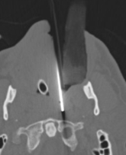
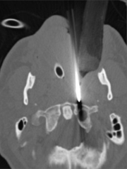
Procedural Images
Figure 2.C
Figure 2.D
Figure 2 Continued:
Intraoperative CT axial images demonstrating
C ) 22gauge Chiba needle placed through the plastic tube to estimate trajectory.
D) 11gauge osseous introducer needle (Stryker) placed onto the anterior cortex of C1.

Slide 12
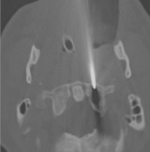
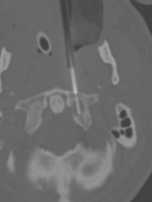
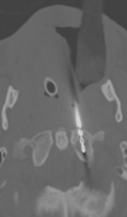
Procedural Images
Figure 2.E
Figure 2.F
Figure 2.G
Figure 2 Continued:
E) Osseous introducer needle advanced into the bone.
F) 2.5cm 13gauge core was acquired through the introducer needle.
G) Optablate sizing drill placed to measure ablation probe size.

Slide 13
Procedural Images
Figure 2.H
Figure 2.I
Figure 2 Continued:
H) 15mm optablate RFA probe placed into the lesion, ablation performed for 4 minutes to achieve ablation zone of 12 mm width.
I) Attempted augmentation with cement extravasation into the soft palate.

Slide 14
Post procedure
Patient was discharged same day, neurologically intact.
Post-procedurally, his neck pain has completely resolved.
The patient will follow up with ENT for throat irritation.
Patient was scheduled for a CT neck with contrast in 2 weeks
Biopsy showed no evidence of malignancy

Slide 15
Educational Info
The 3 percutaneous approaches that exist for C1, are paramaxillary, posterolateral and transoral
Radiofrequency Ablation is the preferred modality for intraosseous spinal ablation
Acceptable therapies include conservative, percutaneous and surgical treatment.
The bone biopsy should include normal bone to evaluate the transition zone.
Patient's individual anatomy dictates specific approach

Slide 16
Educational Info
Careful discussion with the patient about the expectation and the lengthy recovery is very crucial.
Further Literature on transoral approach as a treatment modality of C1 masses would be important for advancement of treatment techniques
Clinical follow up is important part of the patient recovery.

Slide 17
References:
[1] Cianfoni A, Distefano D, Chin SH, Varma AK, Rumboldt Z, Bonaldi G. Percutaneous cement augmentation of a lytic lesion of C1 via posterolateral approach under CT guidance. Spine J. 2012 Jun;12(6):500-6. doi: 10.1016/j.spinee.2012.05.012. Epub 2012 Jun 13. PMID: 22698998.​
[2] Gemmete JJ. Is an Intact Posterior Vertebral Body Cortex Protective for Percutaneous Ablation? AJNR Am J Neuroradiol. 2017 Aug;38(8):1660-1661. doi: 10.3174/ajnr.A5235. Epub 2017 Jun 1. PMID: 28572151; PMCID: PMC7960438.​
[3] Golusiński W. Functional Organ Preservation Surgery in Head and Neck Cancer: Transoral Robotic Surgery and Beyond. Front Oncol. 2019 Apr 17;9:293. doi: 10.3389/fonc.2019.00293. PMID: 31058091; PMCID: PMC6479210.

